Slide 1


ATAL Academy
Faculty Development Programme
on
An Analysis of Breast Cancer using
Machine Learning Techniques
Presented by
Dr. Prakash M
Vellore Institute of Technology, Vellore
Date: 05-Nov-2024

Slide 2
Overview of Breast Cancer: Incidence and Global Statistics
Breast cancer is a type of cancer that develops in the breast tissue, typically in the ducts or lobules. It occurs when abnormal cells grow and multiply uncontrollably, forming a tumor.
Statistics
Worldwide : 2.3 million new cases, 685,000 deaths (2020)
US : 284,000 new cases, 44,000 deaths (2020)
India : 160,000 new cases, 90,000 deaths (2020)
1 in 8 women develop breast cancer in their lifetime
Source: https://www.cancer.org/cancer/types/breast-cancer/about/how-common-is-breast-cancer.html

Slide 3

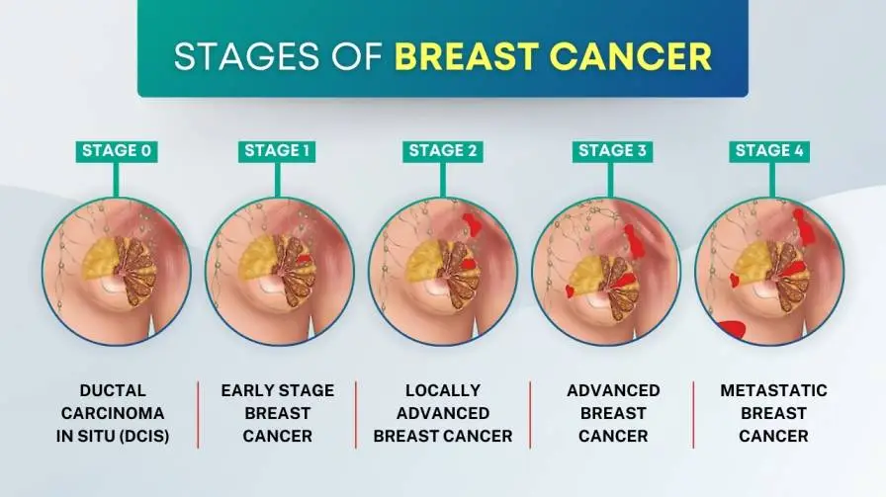
Importance of Early Detection
Cancer staging is a way of describing how far cancer has spread from its original source. It helps doctors plan treatment, assess prognosis, discuss with patients, and in the case of clinical trials, compare and analyze data.
The TNM system is commonly used for breast cancer, which includes tumor size (T), lymph node involvement (N), and the presence of distant metastasis (M).
Early detection increases survival rates:
Stage 0 : 100% 5-year survival rate
Stage I : 99% 5-year survival rate
Stage II : 90% 5-year survival rate
Stage III : 55% 5-year survival rate
Stage IV : 22% 5-year survival rate
Source: https://www.kolhapurcancercentre.com/blog/stages-of-breast-cancer/

Slide 4
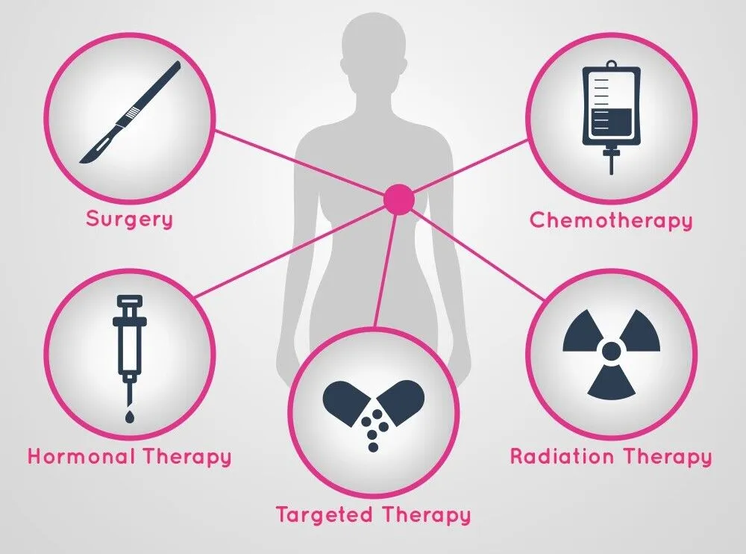
Breast Cancer Treatment

Slide 5
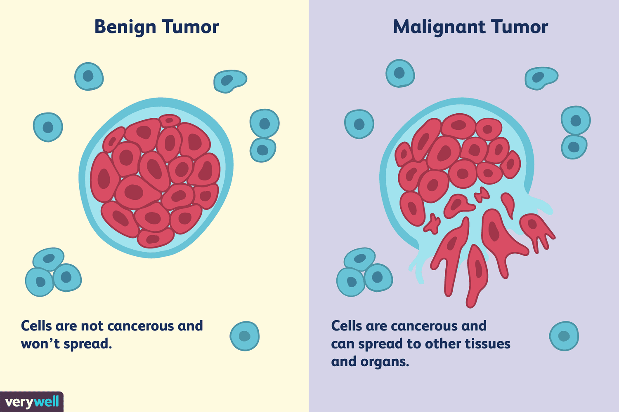
Major Types of Breast Cancer
Source: https://www.healthline.com/health/breast-cancer/types-of-breast-cancer

Slide 6
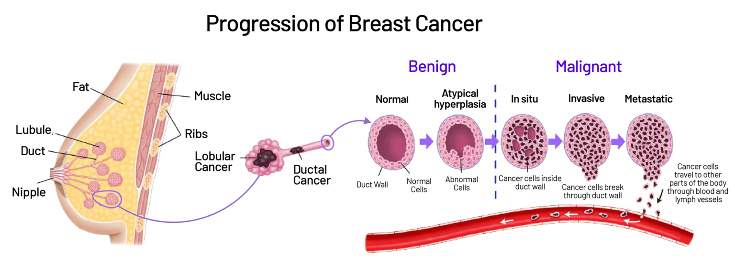
Source: https://www.saintjohnscancer.org/breast/breast-cancer/types-of-breast-cancer/

Slide 7
Breast cancer analysis using machine learning algorithms
1. Large datasets: Breast cancer research has generated extensive datasets, including images, genetic information, and clinical data.
2. Complex patterns: Machine learning algorithms excel at identifying intricate patterns within complex data.
3. Prediction and classification: Algorithms can predict cancer likelihood, classify tumors as benign/malignant, and identify high-risk patients.
4. Feature extraction: Machine learning can extract relevant features from medical images, genomic data, and clinical reports.
5. Personalized medicine: Algorithms can tailor treatment recommendations to individual patient profiles.

Slide 8
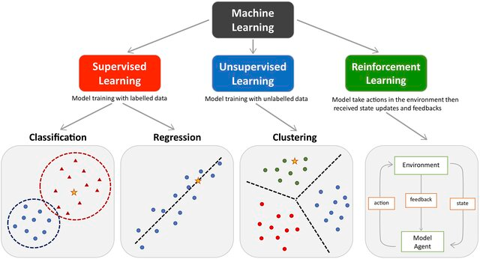
Types of Machine Learning

Slide 9
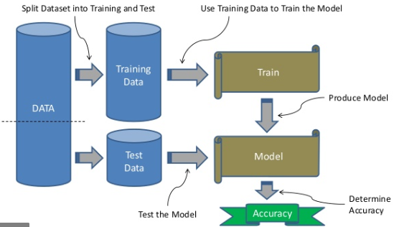
Supervised Machine Learning Algorithm

Slide 10
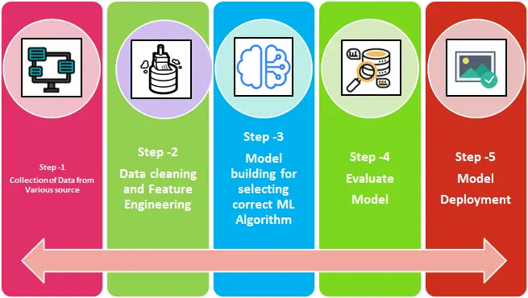
Steps involved in Machine Learning

Slide 11
Step1: Databases and Resources
The Cancer Genome Atlas (TCGA)
Breast Cancer Wisconsin Dataset (UCI Machine Learning Repository)
National Cancer Institute's Clinical Proteomic Tumor Analysis Consortium (CPTAC)
Breast Cancer Gene Expression Profile (BCGEP)
CancerGenomeAtlas (cBioPortal)

Slide 12
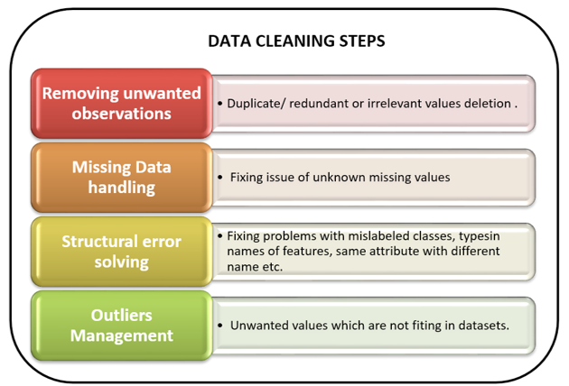
Step2: Data Cleaning

Slide 13
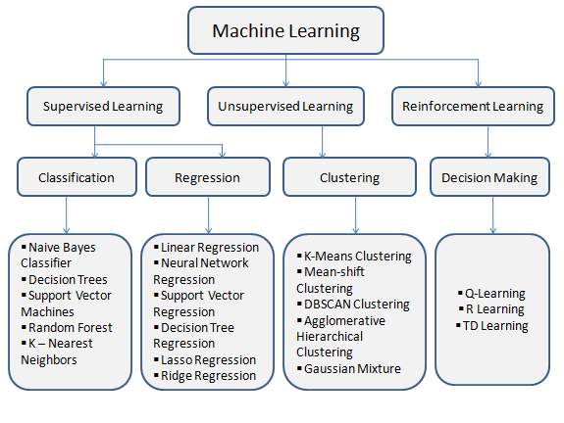
Step3: Machine Learning algorithms

Slide 14
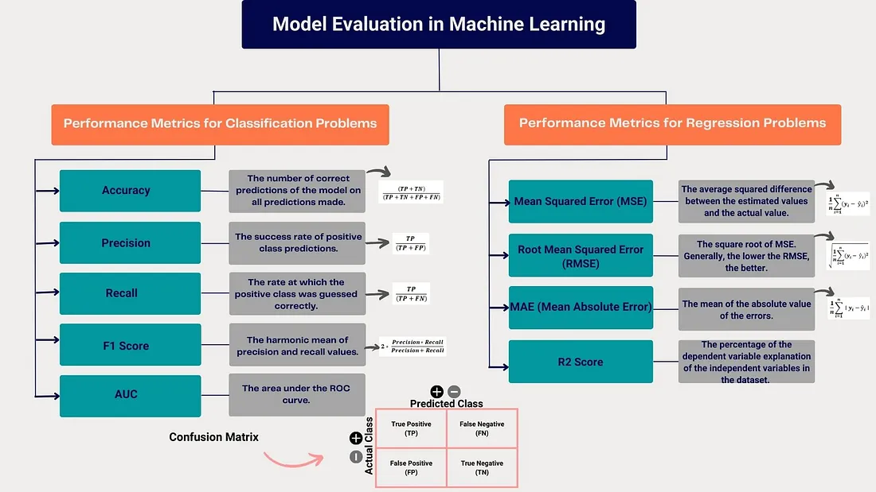
Step4: Model Evaluation
Source: https://medium.com/@neslihannavsar/model-evaluation-metrics-in-machine-learning-classification-and-regression-analysis-aedf99d4fa8a

Slide 15
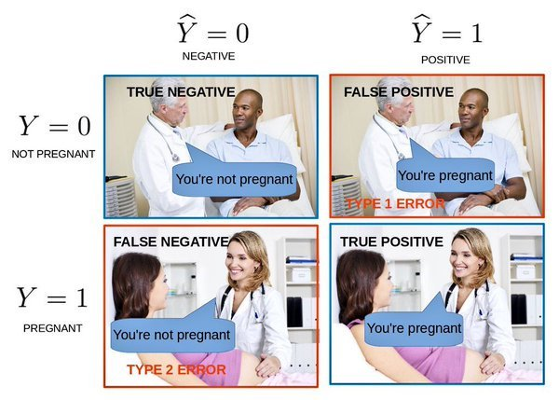
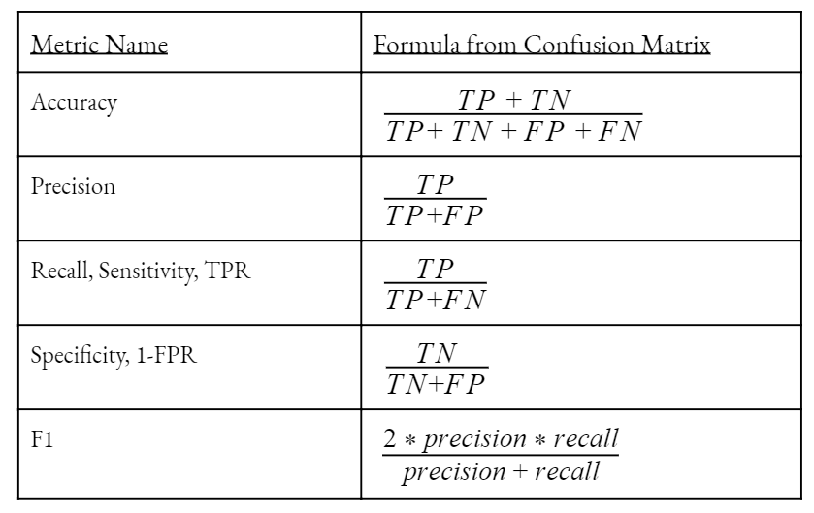
Confusion Matrix
Source: https://medium.com/@neslihannavsar/model-evaluation-metrics-in-machine-learning-classification-and-regression-analysis-aedf99d4fa8a

Slide 16
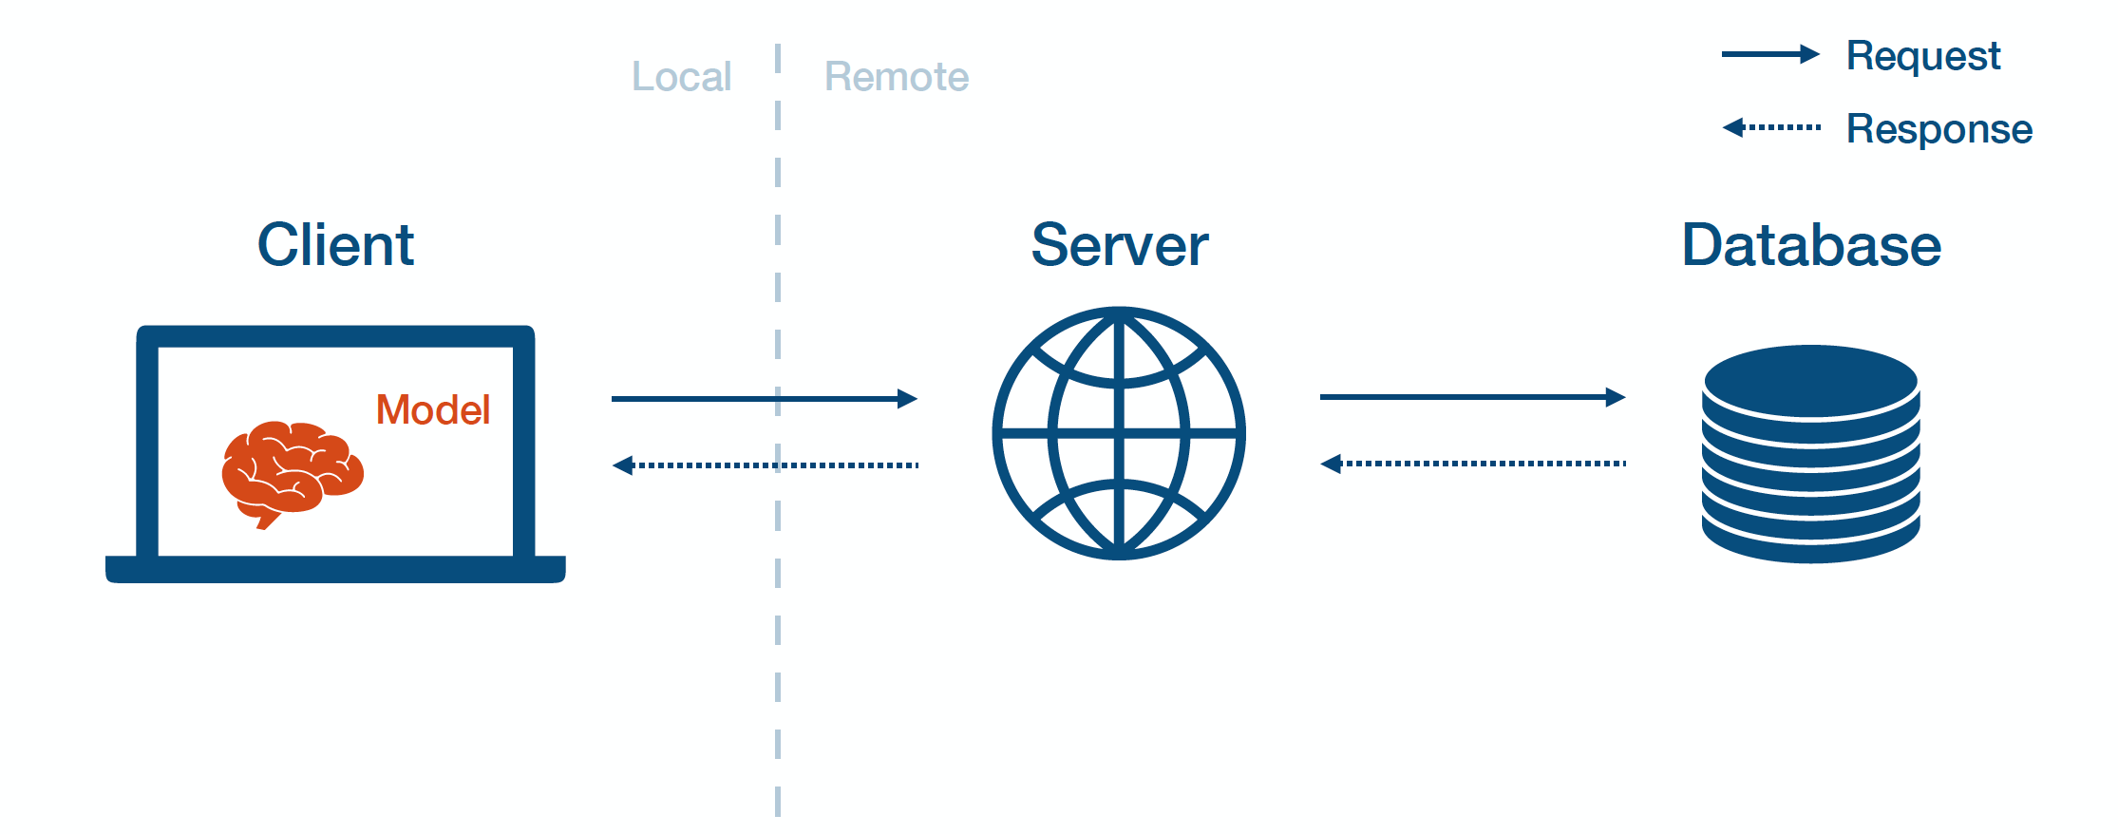
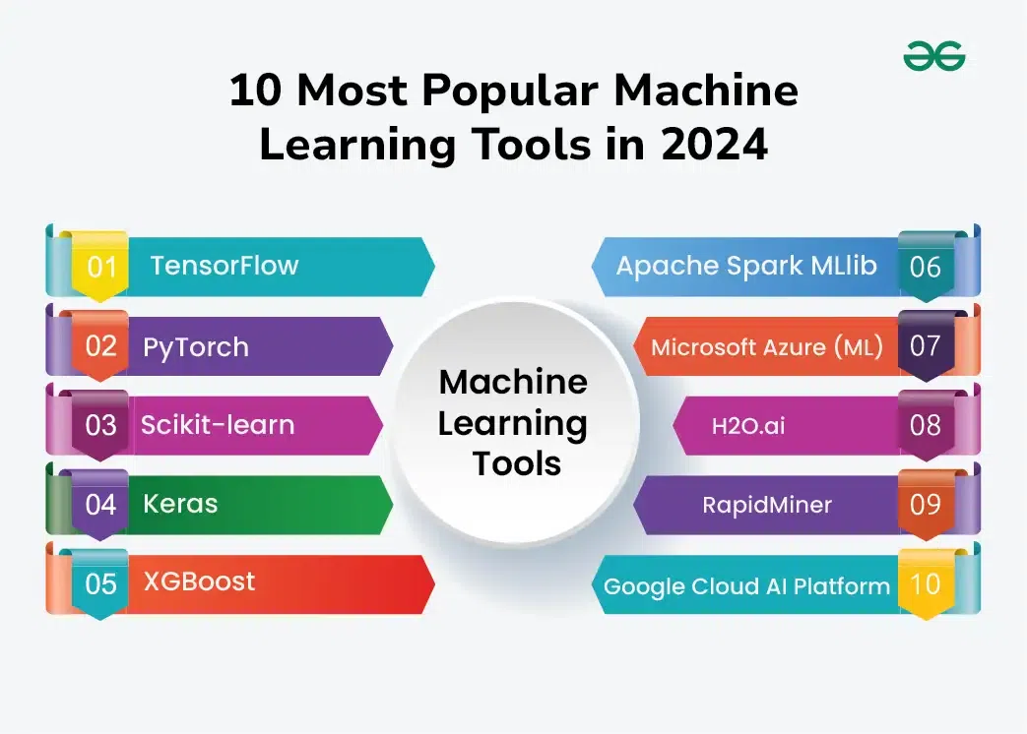
Step5: Model Deployment
Source: https://www.geeksforgeeks.org/popular-machine-learning-tools/

Slide 17
Role of Machine Learning in Healthcare
Machine Learning improves breast cancer detection:
Image analysis:
ML algorithms analyze medical images (mammography, ultrasound, MRI) to detect tumors.
Predictive modeling:
Diagnosis:
ML assists doctors in diagnosing breast cancer.
Personalized medicine:
ML helps tailor treatment plans.

Slide 18
Case Study - Predicting Heart Disease Using Machine Learning
A hospital wants to build a predictive model to estimate a patient’s risk of heart disease. Early prediction helps doctors prioritize high-risk patients and implement preventative measures. The dataset contains features like age, sex, blood pressure, cholesterol level, heart rate, and more.

Slide 19
Challenges and Limitations
Data Quality and Availability
Limited and Imbalanced Data
Missing or Incomplete Data
Feature Selection and Engineering
High Dimensionality
Complexity of Feature Engineering
Interpretability of Models
Complex Models
Lack of Transparency
Data Privacy and Security Concerns
Ethical and Regulatory Challenges
Limitations in Model Accuracy and Reliability
Complexity of Medical Imaging Data

Slide 20
Research Application on Breast Cancer Analysis
Early detection and diagnosis
Predictive modeling for treatment outcomes
Personalized medicine and targeted therapies
Image analysis for tumor segmentation and classification
Genomic and epigenomic analysis for biomarker discovery
Survival analysis and prognostication
Drug discovery and repurposing
Immunotherapy and cancer vaccine development

Slide 21
Future Directions
Integration of Multi-modal Data
Development of Explainable AI Models
Real-time Detection and Diagnosis
Personalized Medicine
Image: Future directions diagram

Slide 22
Learning Resources
https://www.elementsofai.com/
http://web.stanford.edu/class/cs221/
https://www.coursera.org/learn/introduction-tensorflow
https://course.fast.ai/
https://cs50.harvard.edu/ai/2020/
https://www.coursera.org/learn/ai-for-everyone
https://www.coursera.org/learn/machine-learning
https://www.youtube.com/watch?v=7eh4d6sabA0

Slide 23
Demo
https://colab.research.google.com/drive/1kxr-KavvJC-Qv5rnTrN3YHCFAlx8RoSr?usp=sharing

Slide 24


